Slide 1
USER SEGMENTATION USING CLUSTER ANALYSIS
Individual Assignment W6W7W8 (Advanced)
Adytia Putra Pradana
RevoU FSDA Sec. Barcelona

Slide 2
Background
The client (operator) is an e-commerce company based on Latin America. They want to increase their sales because they are not yet using targeted marketing to fully understand the market and their demand.
We use python to clean the data and make cluster analysis to segment the market.
I am their client and to target the right market, first we have to segment their market using cluster analysis. We choose KMeans from python library to do the cluster analysis.
This snake have a lot of library to choose, very powerful and easy to understand language.

Slide 3
DATA PREPARATION
Methodology
INSIGHT & RECOMMENDATION
Creating user segmentation using cluster analysis
Data acquisition, python library preparation, data cleaning
Using cluster(s) from the cluster analysis, recommending strategy to operator
DATA ANALYSIS

Slide 4
Preparation
before we work on the data, first thing to do is import the library that we want to use
we also import silhouette_analysis code
4

Slide 5
Data Gathering
We uses the same datasets from the intermediate assignment which consist of :
orders_dataset
customers_dataset
order_payments_dataset
snippets from orders_dataset
5

Slide 6
Data Gathering
snippets from order_payments_dataset
snippets from customers_dataset
6

Slide 7
Removing Irrelevant Values
first, we make a copy so the original dataset remains,
and we can check/refer back to the original
we remove the column that we won’t use, such as order_purchase_timestamp from orders_dataset
*table shown are example
7

Slide 8
Handling Missing Data
there are some missing data in column order_approved_at and
order_delivered_customer_date, but since we don’t use those data,
we won’t drop the null values, and if dropped then we will lose some
important data from other columns
there are no missing data
there are no missing data
8

Slide 9
Removing Duplicates
!
duplicates are removed
9

Slide 10
Removing Outliers
for outliers, we check and remove the outliers from column payment_value
10

Slide 11
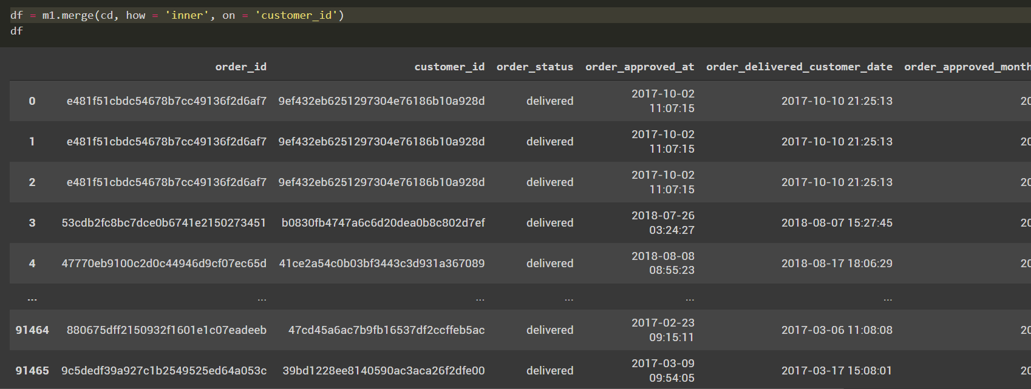
Combine Datasets
we combine the three datasets with inner merge to obtain only same data from each datasets
11

Slide 12
Cluster Analysis
to do cluster analysis, we must import KMeans from sklearn.cluster
we recheck the table to remove column that we don’t need
12

Slide 13
Cluster Analysis
we remove the unneeded column and uses payment_sequential,
payment_type, payment_installments, and payment_value
13

Slide 14
Cluster Analysis
since payment_type is a string, first we convert it to numerical values (integer) using cat.codes function
14

Slide 15
Cluster Analysis
for scaling, we use
MinMaxScaler function
we need to scale the numeric value to match the range for each variables
15

Slide 16
Cluster Analysis
to determine the number of cluster, we can use
elbow method or silhouette analysis
based on the graph, at k value = 4, the decrease of inertia
seems to flatten out
Elbow Method
16

Slide 17
Cluster Analysis
based on the silhouette analysis, we choose the highest score at n_cluster = 4, the score is : 0.5
Silhouette
Analysis
!
because both methods (elbow method & silhouette analysis) recommends 4 clusters, we use it to the next step
17

Slide 18
Cluster Analysis
we input the n_cluster = 4 and insert it
to existing dataframe (df)
18

Slide 19
Cluster Analysis
finally, we can group the data by cluster and payment type and aggregate the data by using payment_value and payment installments
19

Slide 20
Cluster Analysis - Insight
Summary
the distribution of data on each cluster quite good (no cluster with very small count)
Cluster characteristic:
0: prefer to pay with credit card with relatively normal amounts of payment value >> can be named: "middle class people who loves to pay with installments“;
1: prefer to pay with credit card (predominantly) with relatively huge amounts of payment value >> can be named: "high class people who loves to pay with installments“;
2: prefer to pay with boleto (cash) with relatively normal amounts of payment >> can be named: "middle class people who loves to pay with boleto“;
3: prefer to pay with voucher & debit card (cash) with relatively normal amounts of payment >> can be named: "middle class people who loves to pay with debit card & voucher“.
Cluster 0
Cluster 1
Cluster 2
Cluster 3
20

Slide 21
Cluster Analysis
Conclusion and Recommendation
From the cluster analysis, we conclude there are 4 clusters/segmentation of customers.
Operator must give more attention to cluster 0 and cluster 1, because there are higher number of customer who belong to cluster 0 and 1.
For cluster 0 who are middle class people, our client can increase marketing and promos to further increase sales.
For cluster 1, who are higher class, our client can include many benefit from using the credit card so they can have higher retention rate.
There are very few people who use debit card and voucher, the operator have to check whether there is a problem in the payments.
21

Slide 22
Thank You
Terima Kasih

