Slide 1
Individual Assignment W2W3 (Advanced)
Adytia Putra Pradana
RevoU FSDA Sec. Barcelona

Slide 2
Case 2 – Correlation & Regression Analysis
Correlation Heatmap
actual_delivery_time
(days)
payment_
sequential
payment_
installments
payment_
value
price
freight_
value
product_
weight_g
product_
volume_cm3
actual_delivery_time(days) | 1.000 | 0.017 | 0.062 | 0.098 | 0.058 | 0.165 | 0.132 | 0.084
payment_sequential | 0.017 | 1.000 | -0.044 | -0.034 | 0.006 | 0.063 | 0.002 | -0.009
payment_installments | 0.062 | -0.044 | 1.000 | 0.330 | 0.306 | 0.115 | 0.168 | 0.207
payment_value | 0.098 | -0.034 | 0.330 | 1.000 | 0.931 | 0.451 | 0.418 | 0.373
price | 0.058 | 0.006 | 0.306 | 0.931 | 1.000 | 0.384 | 0.333 | 0.303
freight_value | 0.165 | 0.063 | 0.115 | 0.451 | 0.384 | 1.000 | 0.665 | 0.643
product_weight_g | 0.132 | 0.002 | 0.168 | 0.418 | 0.333 | 0.665 | 1.000 | 0.843
product_volume_cm3 | 0.084 | -0.009 | 0.207 | 0.373 | 0.303 | 0.643 | 0.843 | 1.000
1
0
-1
= the correlation we want to check
2

Slide 3
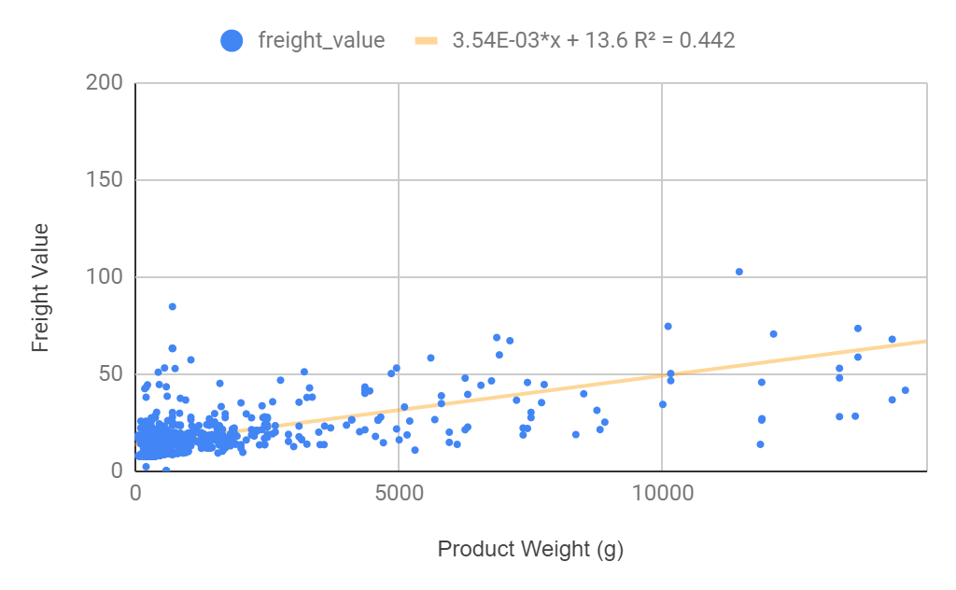
Case 2 – Correlation & Regression Analysis
Freight Value vs Product Weight (g)
 | Correlation | slope | intercept
Freight Value vs Product Weight (g) | 0.6648708359 | 0.003544616393 | 13.63751187
Freight Value vs Product Weight (g)
coefficient for slope, coefficient for intercept | 0.003544616393 | 13.63751187
standard error for slope, standard error for intercept | 0.0001553623057 | 0.5747353545
coefficient of determination, standard error | 0.4420532284 | 12.97433351
F stat with degree of freedom | 520.5316813 | 657
regression SS, residual SS | 87622.83126 | 110594.9978
Freight Value (forecast) | Product Weight (g)
49.0836758 | 10000
Description
Terdapat korelasi linear yang kuat antara freight value dengan product weight (g) - Correlation 0,66
r | 0.6648708359
n | 659
t-score | 22.81516341
p-value | 0
Karena p-value lebih kecil dari 0,05 maka terdapat korelasi yang signifikan antara freight value dan product weight (g).
3

Slide 4
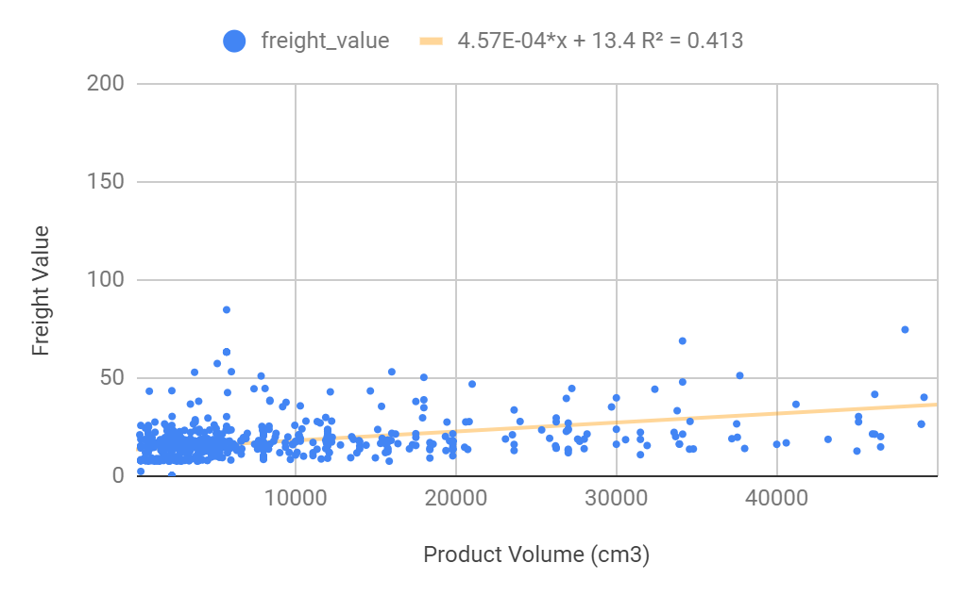
Case 2 – Correlation & Regression Analysis
Freight Value vs Product Volume (cm3)
 | Correlation | slope | intercept
Freight Value vs Product Volume (cm) | 0.6427839138 | 0.0004570010131 | 13.40032514
Freight Value vs Product Volume (cm3)
coefficient for slope, coefficient for intercept | 0.0004570010131 | 13.40032514
standard error for slope, standard error for intercept | 0.00002124834959 | 0.5995410481
coefficient of determination, standard error | 0.4131711599 | 13.30590436
F stat with degree of freedom | 462.5768767 | 657
regression SS, residual SS | 81897.89033 | 116319.9387
Freight Value (forecast) | Product Volume (cm3)
17.97033527 | 10000
Description
Terdapat korelasi linear yang kuat antara freight value dengan product volume (cm3) - Correlation 0,64
r | 0.6427839138
n | 659
t-score | 21.50760044
p-value | 0
Karena p-value lebih kecil dari 0,05 maka terdapat korelasi yang signifikan antara freight value dan product volume.
4

Slide 5
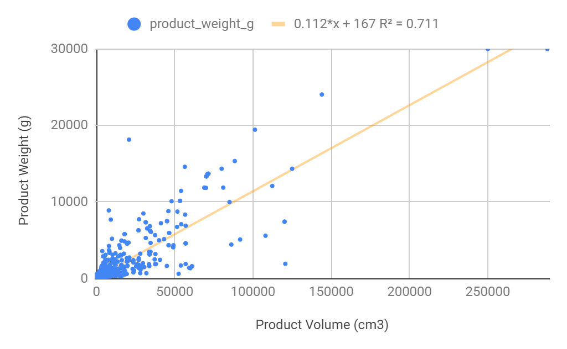
Case 2 – Correlation & Regression Analysis
Product Weight (g) vs Product Volume (cm3)
 | Correlation | slope | intercept
Product Weight (g) vs Product Volume (cm3) | 0.8432042031 | 0.112448319 | 166.7785572
Product Weight (g) vs Product Volume (cm3)
coefficient for slope, coefficient for intercept | 0.112448319 | 166.7785572
standard error for slope, standard error for intercept | 0.002796993483 | 78.91965429
coefficient of determination, standard error | 0.7109933282 | 1751.502046
F stat with degree of freedom | 1616.30392 | 657
regression SS, residual SS | 4958431570 | 2015517937
Product Weight (g) (forecast) | Product Volume (cm3)
189.268221 | 200
Description
Terdapat korelasi linear yang sangat kuat antara product weight (g) dengan product volume (cm3) - Correlation 0,84
r | 0.8432042031
n | 659
t-score | 40.20328245
p-value | 0
Karena p-value lebih kecil dari 0,05 maka terdapat korelasi yang signifikan antara product weight (g) dan product volume (cm3).
5

Slide 6
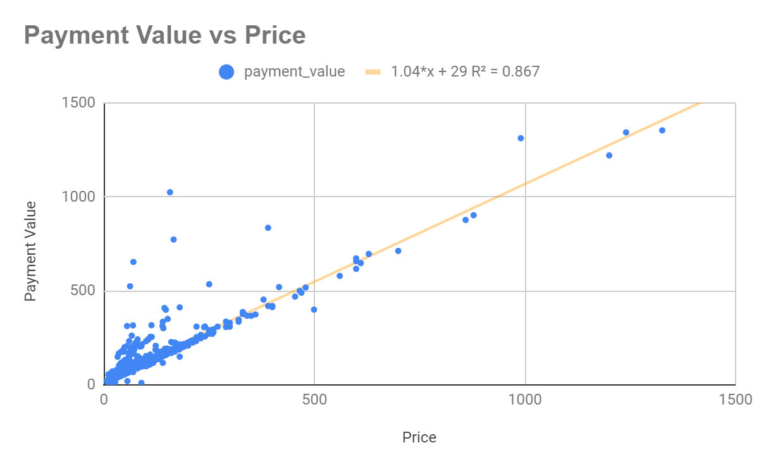
Case 2 – Correlation & Regression Analysis
Payment Value vs Price
 | Correlation | slope | intercept
Payment Value vs Price | 0.9313732708 | 1.038993674 | 28.97733538
Payment Value vs Price
coefficient for slope, coefficient for intercept | 1.038993674 | 28.97733538
standard error for slope, standard error for intercept | 0.01584477977 | 3.093567008
coefficient of determination, standard error | 0.8674561696 | 64.55527933
F stat with degree of freedom | 4299.850861 | 657
regression SS, residual SS | 17919130.07 | 2737971.347
Payment Value (forecast) | Price
10418.91408 | 10000
Description
Terdapat korelasi linear yang sangat kuat antara payment value dengan price - Correlation 0,93
r | 0.9313732708
n | 659
t-score | 65.57324806
p-value | 0
Karena p-value lebih kecil dari 0,05 maka terdapat korelasi yang signifikan antara payment value dan price.
6

Slide 7
Case 3 – A/B Testing
The test was conducted between two group – control, and treatment. We want to check whether the new page (treatment group) will give a better conversion rate.
Test whether the hypothesis is proven or not using z-test
Determine whether the test reject or fail to reject the hypothesis
For the test, we use the one-tailed z test because the hypothesis state that the treatment group will give a better conversion rate.
7

Slide 8
Case 3 – A/B Testing
I. Hypotheses
H0 conversion rate = 0.1257142857
H1 conversion rate > 0.1257142857
Signifcance level = 95%, alpha = 0.05
II. Summary
Conversion rate = | 0.1314285714
III. P-value = | 0.1961776271
IV. Conclusion
Failed to Reject H0
Sample mean | 0.1314285714
Population mean | 0.1257142857
stdev | 0.3315947583
n (sample) | 2450 |  | Z(critical value) derived from table at significance level of 95%
Z | 0.8529770312 |  | 1.645
P value | 0.196857
Z = 0.853 < 1.645, therefore Hypothesis is not proven |  |  | P = 0.196 > 0.05, therefore failed to reject H0
group | AVERAGE of converted | STDEV of converted | COUNTA of converted
control | 0.1257142857 | 0.3315947583 | 2450
treatment | 0.1314285714 | 0.3379374424 | 2450
8

